Slide 1
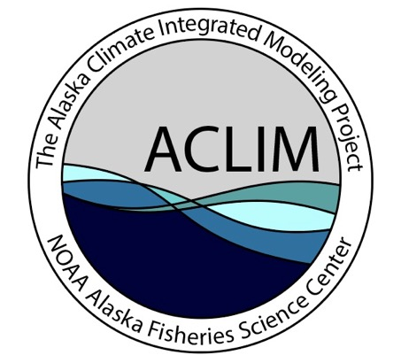
ACLIM2 Team
Lead PIs: Anne Hollowed, Kirstin Holsman, Alan Haynie, Jon Reum, Andre Punt, Kerim Aydin, Al Hermann
Wei Cheng
Jim Ianelli
Kelly Kearney
Elizabeth McHuron
Daren Pilcher
Jeremy Sterling
Ingrid Spies
Paul Spencer
William Stockhausen
Cody Szuwalski
Sarah Wise
Ellen Yasumiishi
Andy Whitehouse
James Thorson
Peggy Sullivan
Amanda Faig
Steve Kasperski
Martin Dorn
Diana Evans
Ed Farely
Enrique Curchitser
Elliott Hazen
David Kimmel
Mike Jacox
Stan Kotwicki
Ivonne Ortiz
Kalei Shotwell
Rolf Ream
Elizabeth Siddon
Phyllis Stabeno
Charlie Stock
Chris Rooper
Jordan Watson
Diana Stram
Lauren Rogers
Ben Laurel
Maxime Olmos
Steve Barbeaux
Adam Hayes
Building Pathways To Resilience Through Evaluation of Climate Impacts, Risk, & Adaptation Responses of Marine Ecosystems, Fisheries, & EBS Coastal Communities
www.fisheries.noaa.gov/alaska/ecosystems/alaska-climate-integrated-modeling-project

Slide 2
ACLIM 2.0 BUILDING PATHWAYS TO RESILIENCE THROUGH EVALUATION OF CLIMATE IMPACTS, RISK, & ADAPTATION RESPONSES OF MARINE ECOSYSTEMS, FISHERIES, & EBS COASTAL COMMUNITIES

Slide 3
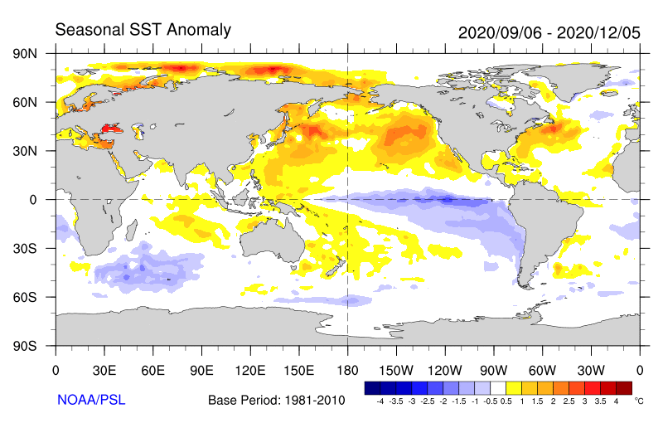
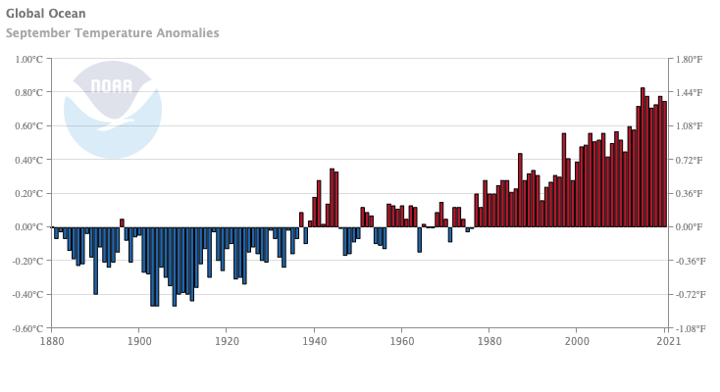
Anomaly from 1961-1990 climatology, 1 degree, weekly resolution
https://psl.noaa.gov/map/clim/sst.shtml
NOAA National Centers for Environmental information, Climate at a Glance: Global Time Series, published May 2021, retrieved on May 28, 2021 from https://www.ncdc.noaa.gov/cag/

Slide 4
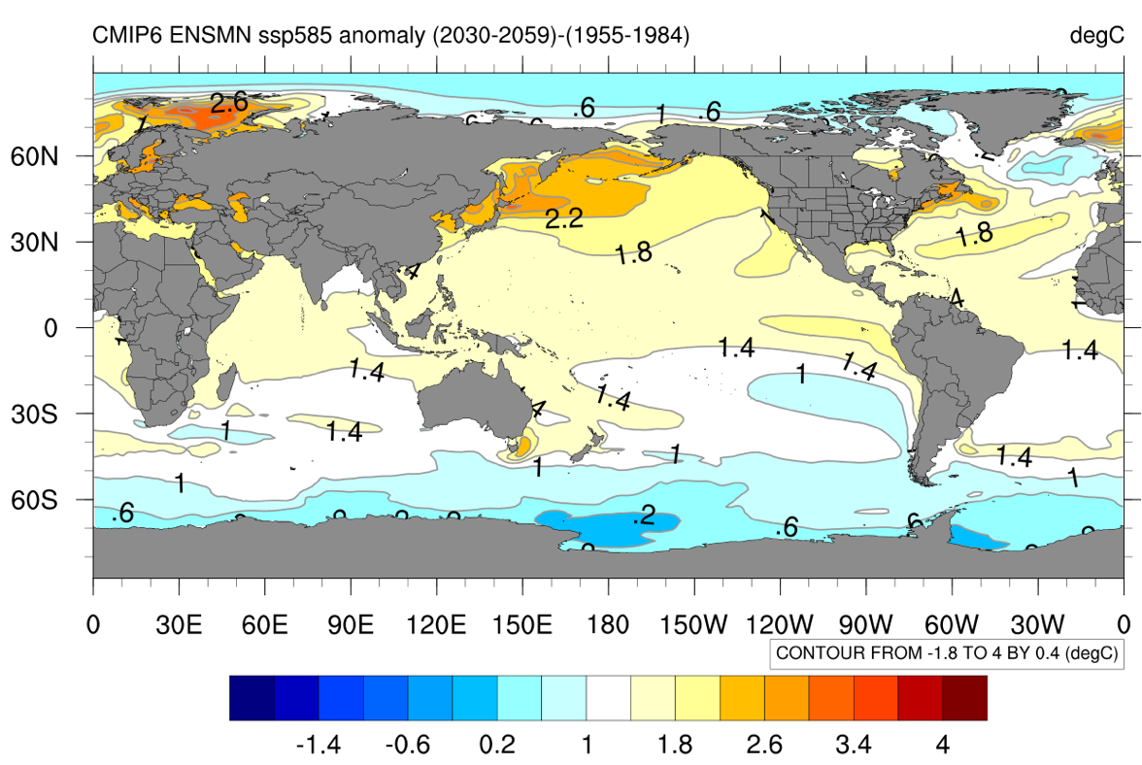
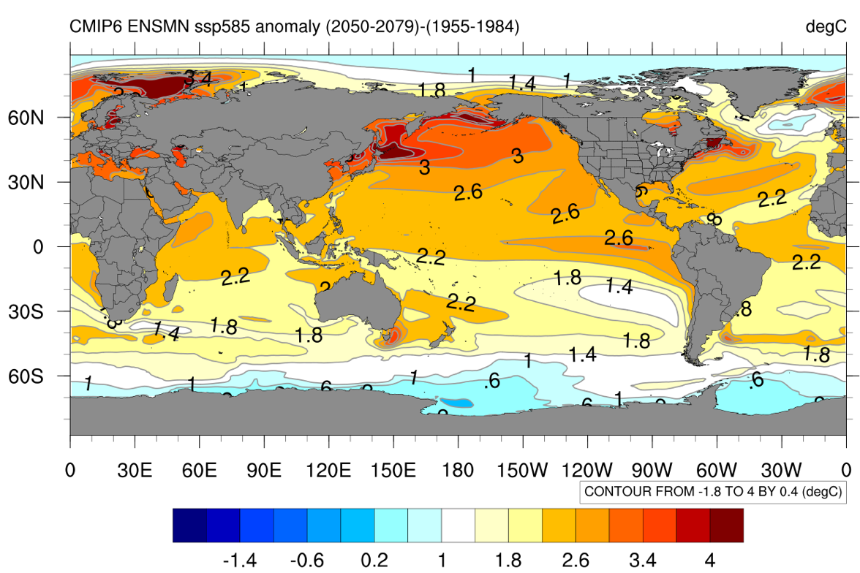
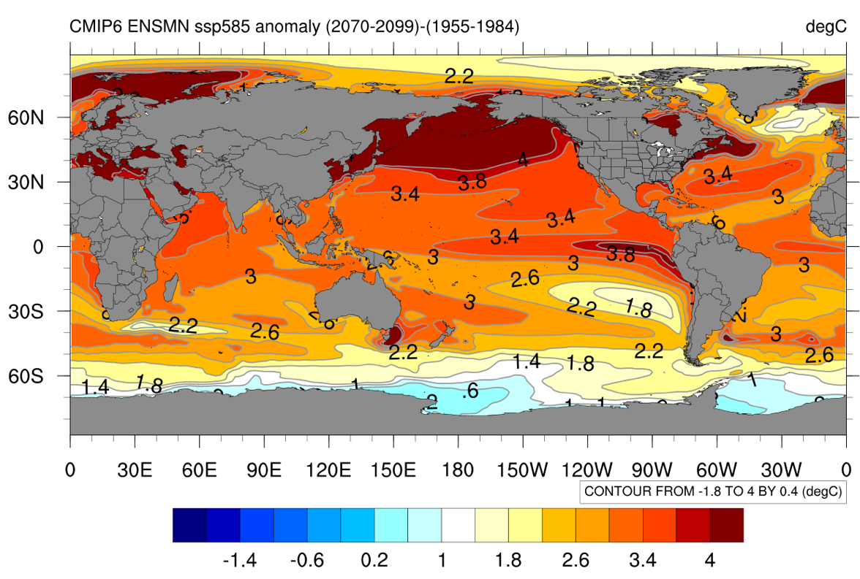
CMIP6: SST Anomaly from 1955-1984 climatology
CMIP6 PROJECTIONS
https://psl.noaa.gov/ipcc/cmip6/

Slide 5
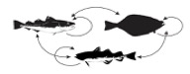
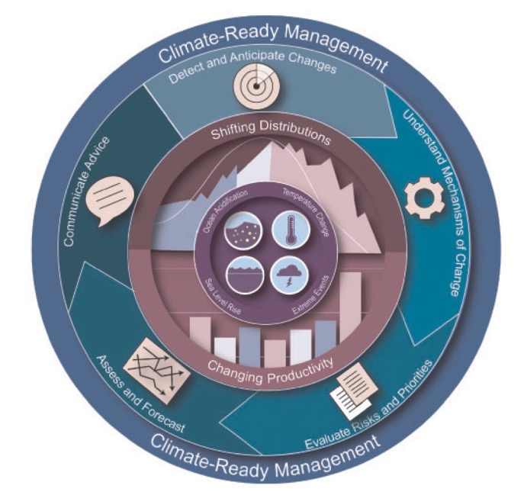
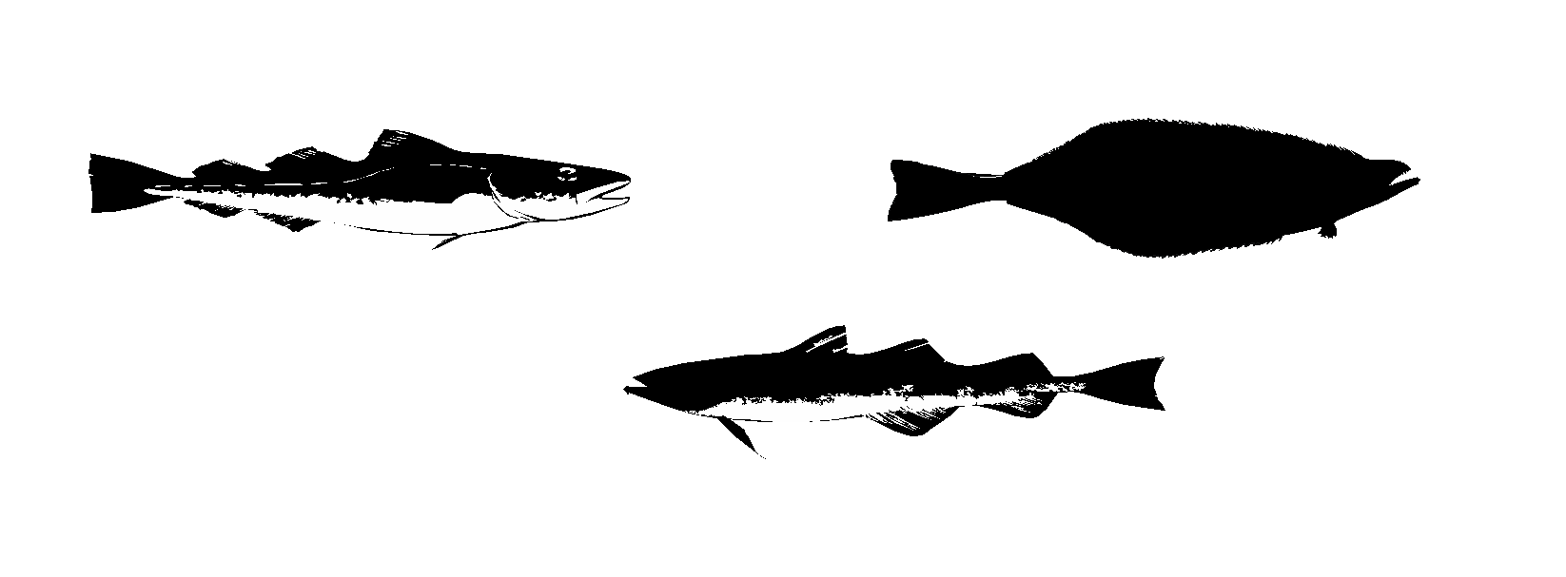
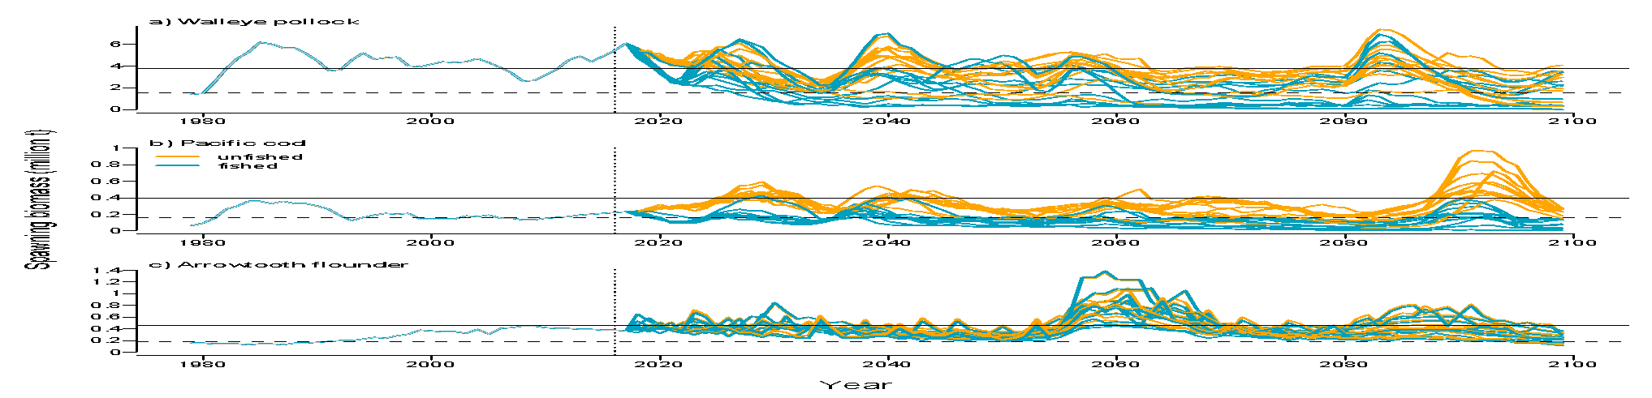
Management can reduce risks & support adaptation
Climate
Biological Model
Adaptation
Catch
ABC
Adaptation
Adaptation
Fisher Model
Management Model
Adaptation
Spawning biomass
Unfished
Fished
Karp et al. 2019. Accounting for Shifting Distributions and Changing Productivity in the Development of Scientific Advice for Fishery Management. ICES JMS doi: 10.1093/icesjms/fsz048

Slide 6
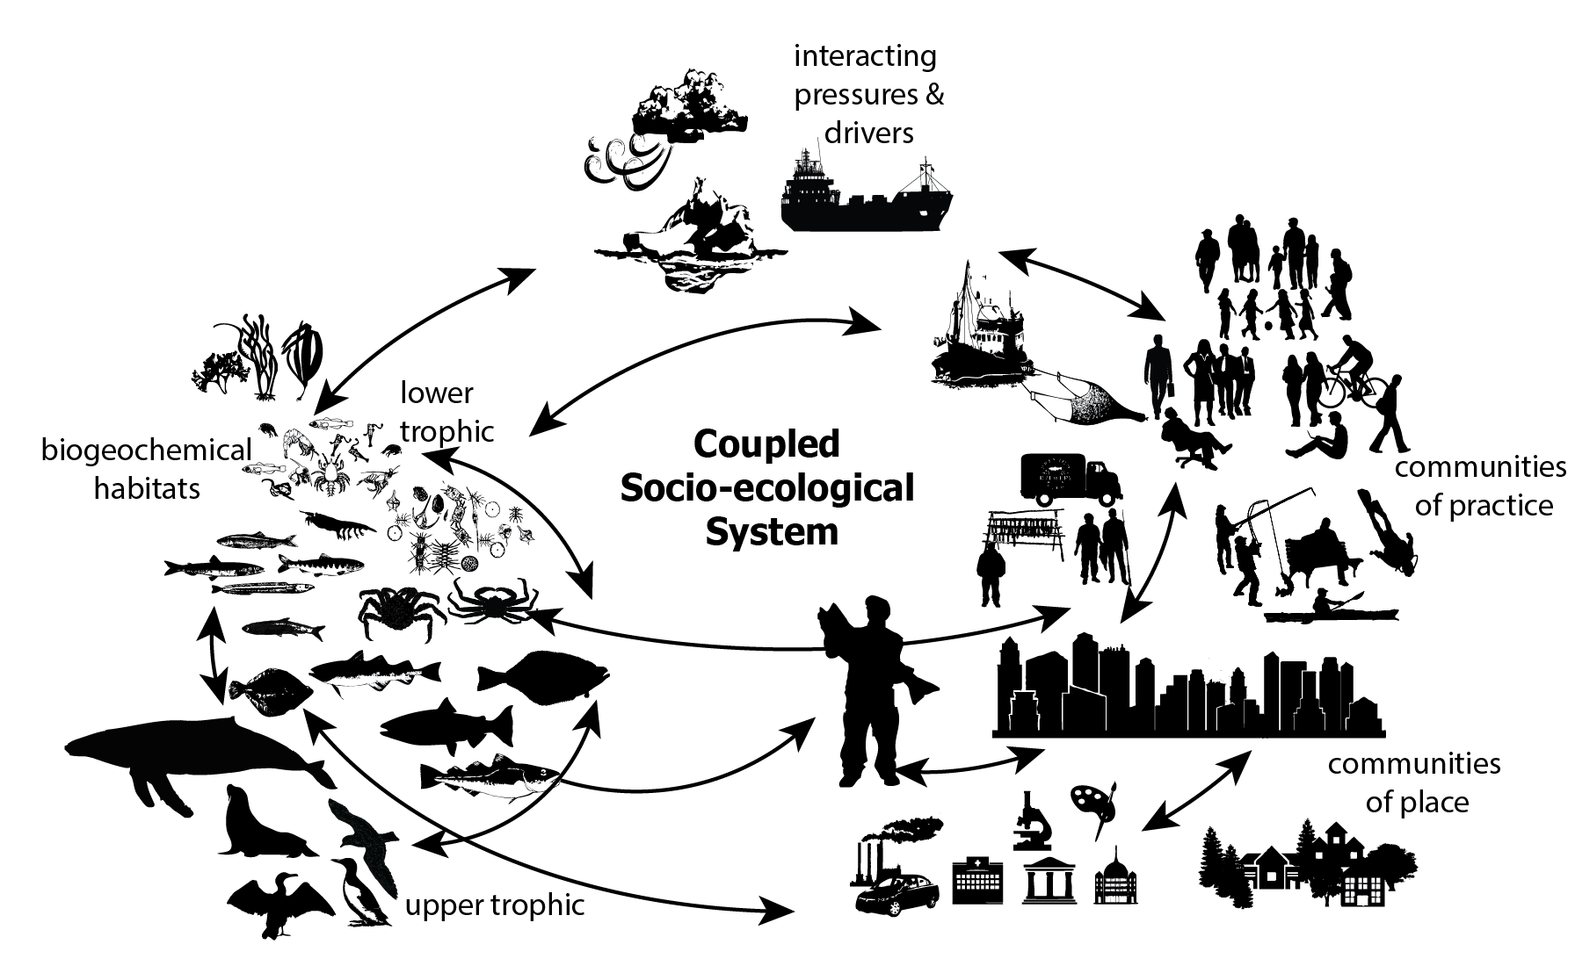
Glossary of Terms: Social-ecological system
Human and ecological systems are linked through feedback mechanisms
Adaptation
Resilience
Adaptation
Resilience

Slide 7
Timeline
Presentations to Eco. Comm
April: NPMFC scenarios workshop
Summer: NPMFC Econ.
Scenarios Workshop
April: SSC Social-ecological ppt
Jan: SSC ROMSNPZ presentation
Mar: Ensemble workshop
May: Fisheries Forum (CA)
Mar: ACLIM Repo
ACLIM Funded
Dec: Council FEP &
Climate module adopted
Oct: ACLIM Phase 2 kickoff
2015
2016
2017
2018
2019
2020
2021
2022
2023
2024
ACLIM Proposal
Jun: CMIP5 downscaling complete
Dec: CMIP6 downscaling complete
Oct: ACLIM B0 results presented to the Council
Feb: ACLIM ROMSNPZ data online (PMEL server)
Feb: Ecosystem Workshop
Oct: ACLIM projections included in
CEATTLE multispp assessment

Slide 8
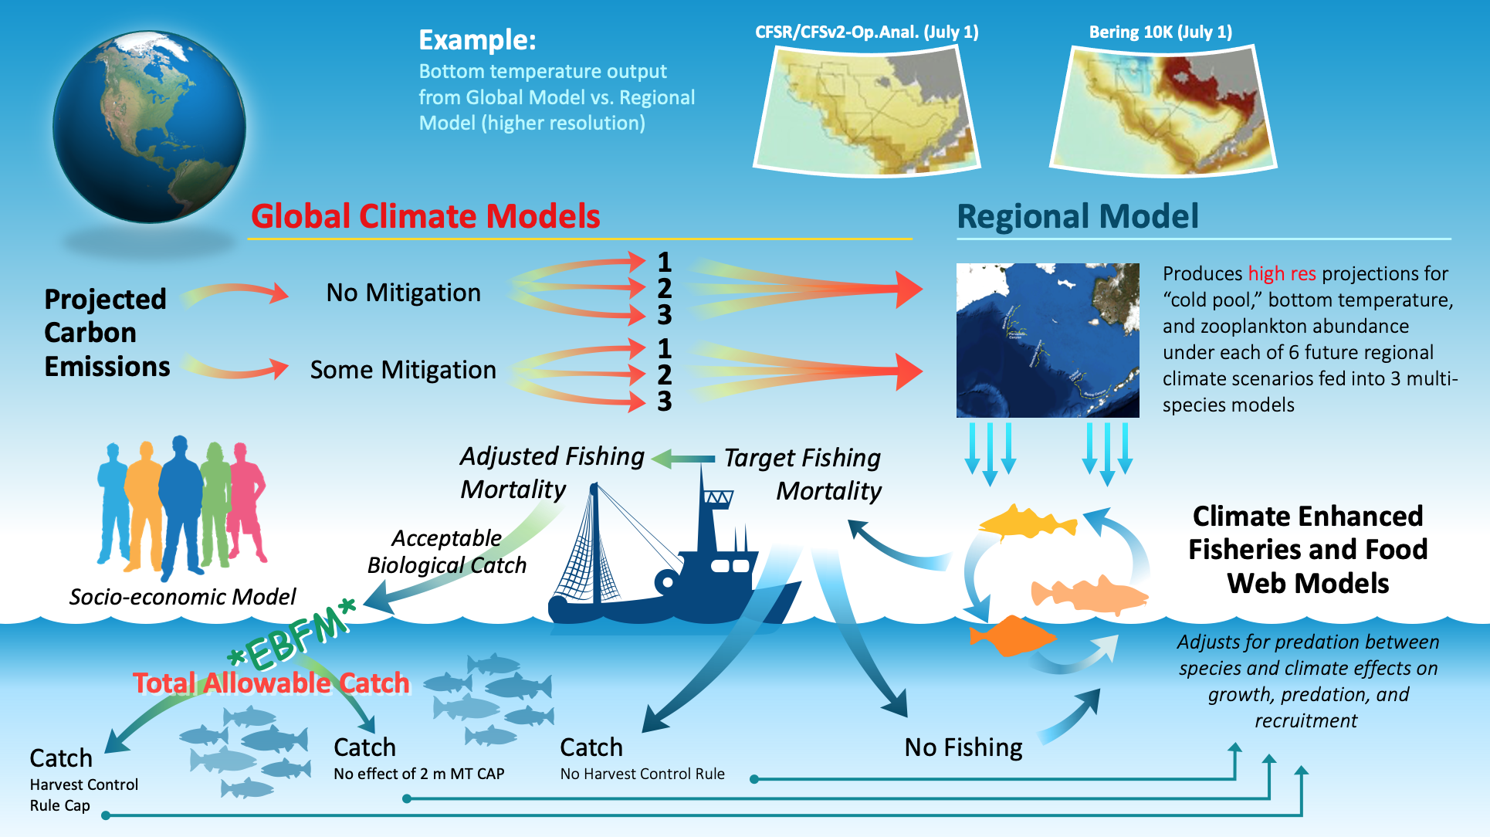

Slide 9
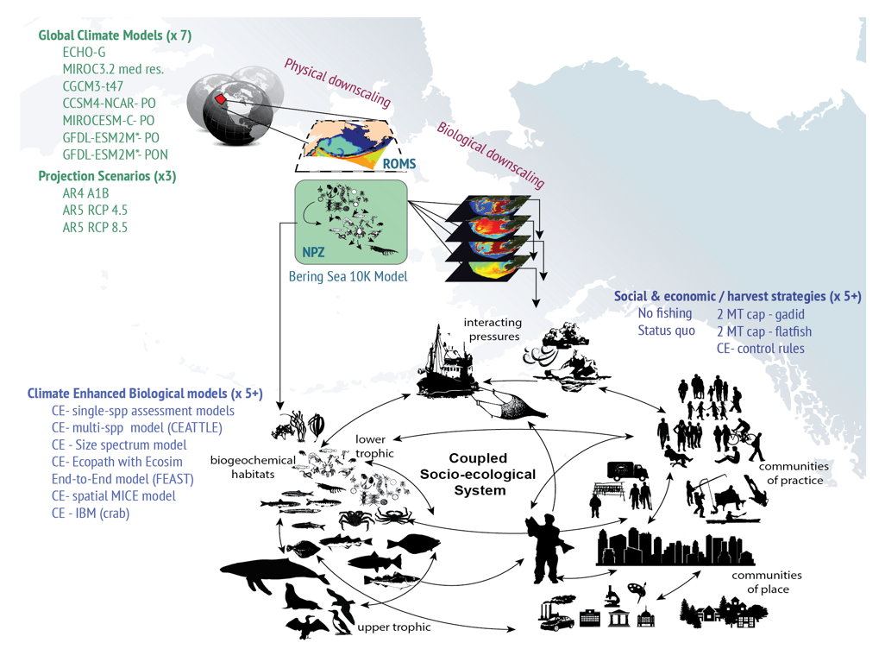





The Alaska Climate Integrated Modeling Project
Operational suite of coupled socio-ecological models for climate fisheries hindcasts, forecasts, projections and Management Strategy Evaluation
www.fisheries.noaa.gov/alaska/ecosystems/alaska-climate-integrated-modeling-project
NOAA COCA
AFSC
Hollowed et al. 2020. Frontiers in Mar. Sci. doi: 10.3389/fmars.2019.00775

Slide 10





BOM (Bering Ocean Modeling Team) --> ACLIM runs
Kerim Aydin
Kelly Kearney
Albert Hermann
Ivonne Ortiz
Wei Cheng

Slide 11
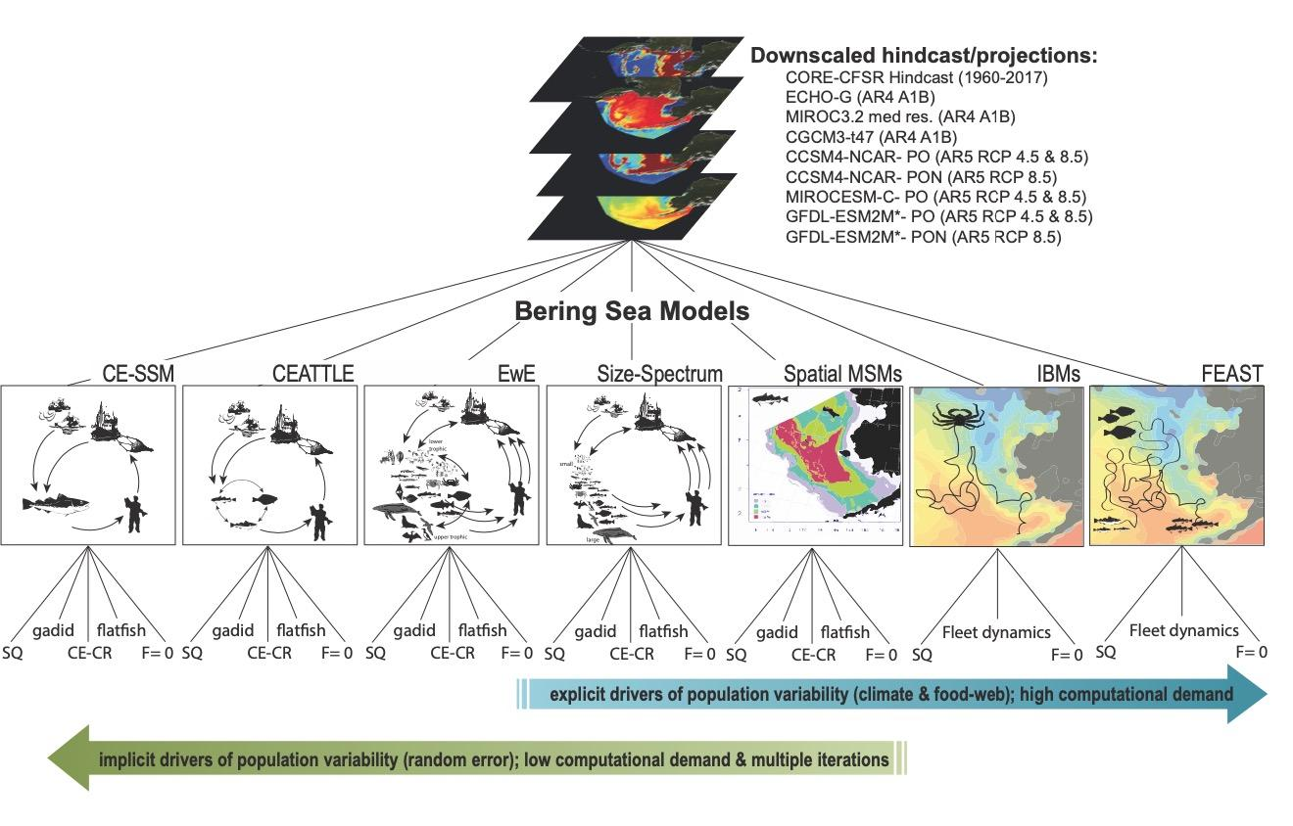
The Alaska Climate Integrated Modeling Project
historical, SSP 126, SSP 585
historical, SSP 126, SSP 585
historical, SSP 126, SSP 585

Slide 12
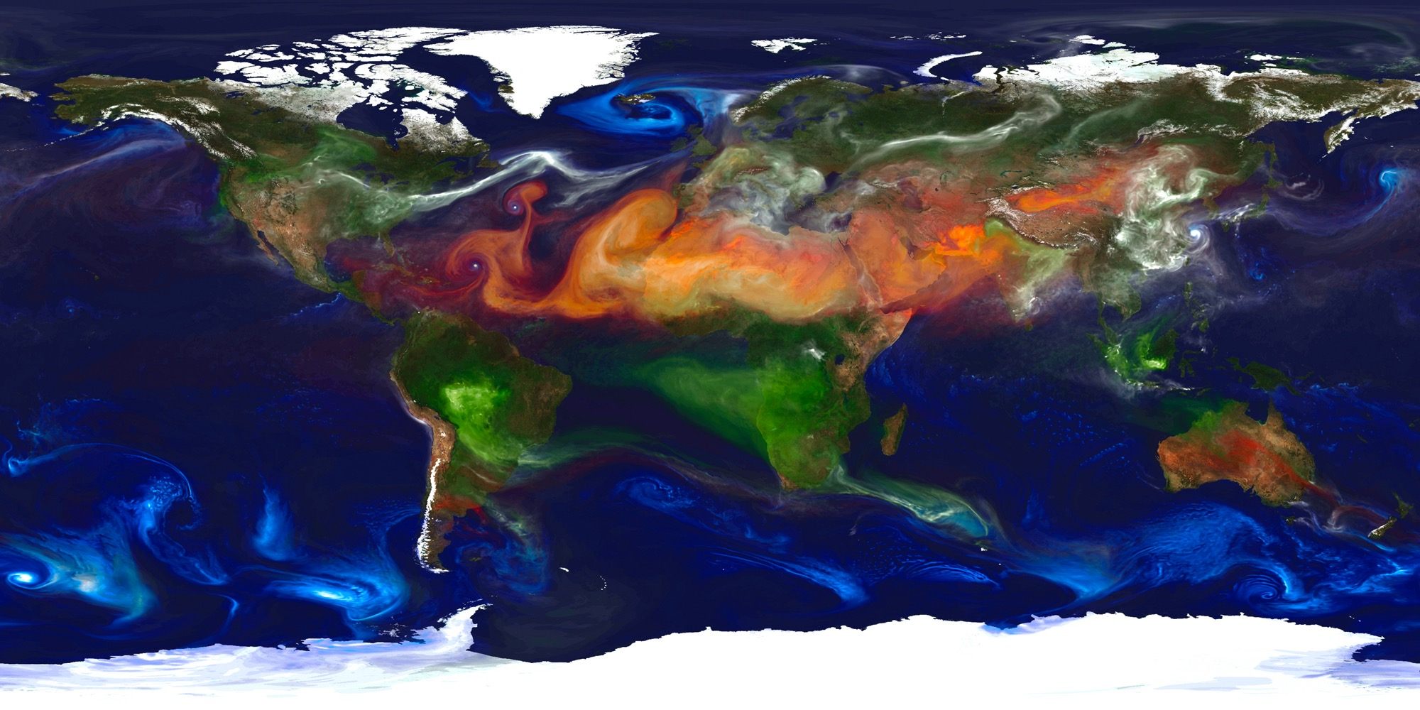
CLIMATE PROJECTIONS
CLIMATE SCENARIOS
Coupled Model
Intercomparison Project
(CMIP)
This portrait of global aerosols was produced by a GEOS-5 simulation at a 10-kilometer resolution. Dust (red) is lifted from the surface, sea salt (blue) swirls inside cyclones, smoke (green) rises from fires, and sulfate particles (white) stream from volcanoes and fossil fuel emissions. Image credit: William Putman, NASA/Goddard https://www.nasa.gov/multimedia/imagegallery/image_feature_2393.html
Notes:
CMIP6 has 49 modeling centers involved (up from ~2 dozen for CMIP5)

Slide 13
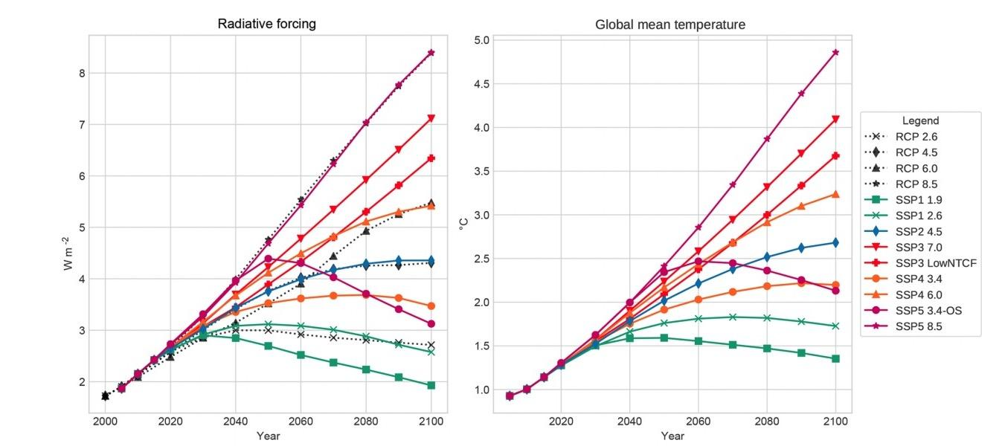
Carbon Emission Scenarios
“plausible descriptions of how the future may evolve with respect to a range of variables…they are not meant to be policy prescriptive, (i.e. no likelihood or preference is attached to any of the individual scenarios of the set)”
van Vuuren et al. 2011
Gidden et al. (2019). Global emissions pathways under different socioeconomic scenarios for use in CMIP6: a dataset of harmonized emissions trajectories through the end of the century. Geosci. Model Dev., 12, 1443–1475, 2019 https://doi.org/10.5194/gmd-12-1443-2019
Notes:
“Socio-economic and emission scenarios are used in climate research to provide plausible descriptions of how the future may evolve with respect to a range of variables including socio-economic change, technological change, energy and land use, and emissions of greenhouse gases and air pollutants. They are used as input for climate model runs and as a basis for assessment of possible climate impacts and mitigation options and associated costs. “ Van vuuren et al. 2011
The RCPs should not be interpreted as forecasts or absolute bounds, or be seen as policy prescriptive. The RCPs describe a set of possible developments in emissions and land use, based on consistent scenarios representative of current literature (see Section 2). The RCPs should clearly not be interpreted as boundaries for possible developments with respect to emissions and land use. Similarly, while the RCPs may be used to identify the range of climate impacts associated with different anthropogenic forcing levels, they are not meant to be policy prescriptive, (i.e. no likelihood or preference is attached to any of the individual scenarios of the set). At the same time, the use of the RCPs in climate research may provide important information for decision-making

Slide 14
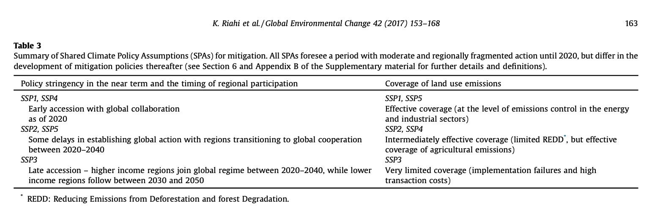
Notes:
“Socio-economic and emission scenarios are used in climate research to provide plausible descriptions of how the future may evolve with respect to a range of variables including socio-economic change, technological change, energy and land use, and emissions of greenhouse gases and air pollutants. They are used as input for climate model runs and as a basis for assessment of possible climate impacts and mitigation options and associated costs. “ Van vuuren et al. 2011
The RCPs should not be interpreted as forecasts or absolute bounds, or be seen as policy prescriptive. The RCPs describe a set of possible developments in emissions and land use, based on consistent scenarios representative of current literature (see Section 2). The RCPs should clearly not be interpreted as boundaries for possible developments with respect to emissions and land use. Similarly, while the RCPs may be used to identify the range of climate impacts associated with different anthropogenic forcing levels, they are not meant to be policy prescriptive, (i.e. no likelihood or preference is attached to any of the individual scenarios of the set). At the same time, the use of the RCPs in climate research may provide important information for decision-making

Slide 15
Gidden et al. (2019). Global emissions pathways under different socioeconomic scenarios for use in CMIP6: a dataset of harmonized emissions trajectories through the end of the century. Geosci. Model Dev., 12, 1443–1475, 2019 https://doi.org/10.5194/gmd-12-1443-2019
Notes:
“Socio-economic and emission scenarios are used in climate research to provide plausible descriptions of how the future may evolve with respect to a range of variables including socio-economic change, technological change, energy and land use, and emissions of greenhouse gases and air pollutants. They are used as input for climate model runs and as a basis for assessment of possible climate impacts and mitigation options and associated costs. “ Van vuuren et al. 2011
The RCPs should not be interpreted as forecasts or absolute bounds, or be seen as policy prescriptive. The RCPs describe a set of possible developments in emissions and land use, based on consistent scenarios representative of current literature (see Section 2). The RCPs should clearly not be interpreted as boundaries for possible developments with respect to emissions and land use. Similarly, while the RCPs may be used to identify the range of climate impacts associated with different anthropogenic forcing levels, they are not meant to be policy prescriptive, (i.e. no likelihood or preference is attached to any of the individual scenarios of the set). At the same time, the use of the RCPs in climate research may provide important information for decision-making

Slide 16
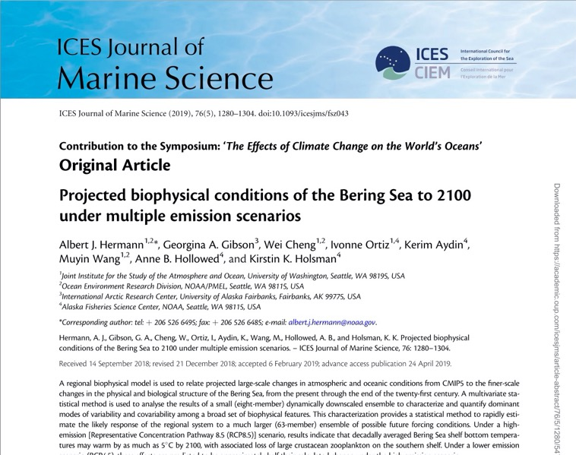
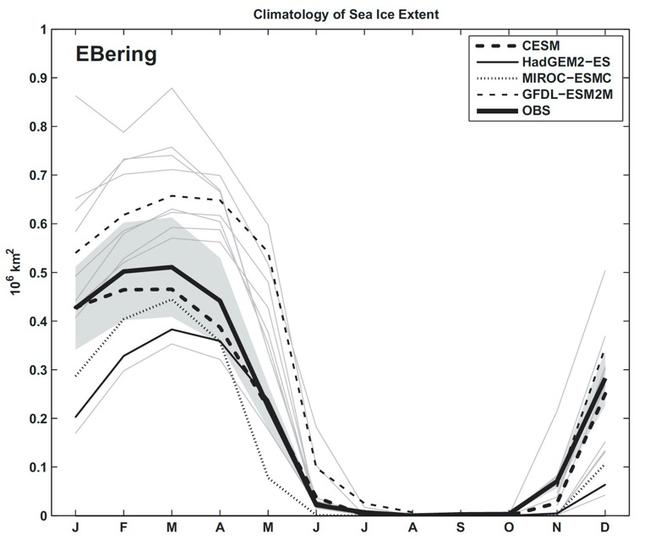
Projections: selection of (Global Ocean) General Circulation Models (GCMs)
1980-1999
GFDL ESM2M (cooler)
CESM (intermediate)
MIROC ESMC (warmer)
Criteria for selection:
Carbonate dynamics
ESM models (have PON)
Realistic timing of Sea Ice melt
Spans warm, average, cool
Hermann, A. J., G.A. Gibson, W. Cheng, I. Ortiz1,K. Aydin, M. Wang, A. B. Hollowed, and K. K. Holsman. (2019) Projected biophysical conditions of the Bering Sea to 2100 under multiple emission scenarios. ICES. doi: 10.1093/ices/fsz043

Slide 17
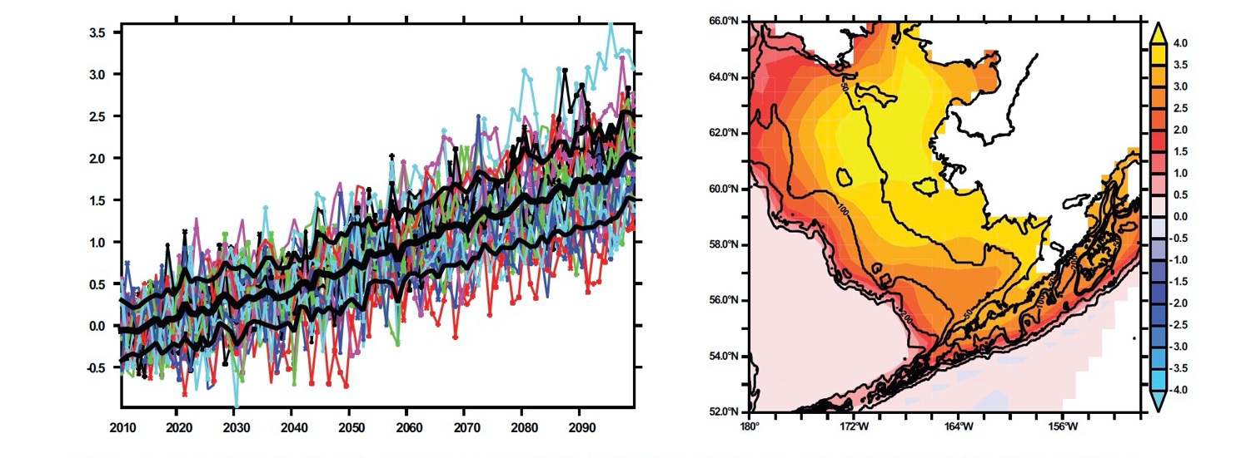
Results: Downscaled Bering10K ROMSNPZ high-resolution model (H16)
∆ Bottom Temp (ºC) (whole basin)
RCP 8.5
INCREASED WARMING (2090-2099)-(2010-2019)
Hermann, A. J., G.A. Gibson, W. Cheng, I. Ortiz1,K. Aydin, M. Wang, A. B. Hollowed, and K. K. Holsman. (2019) Projected biophysical conditions of the Bering Sea to 2100 under multiple emission scenarios. ICES. doi: 10.1093/ices/fsz043

Slide 18
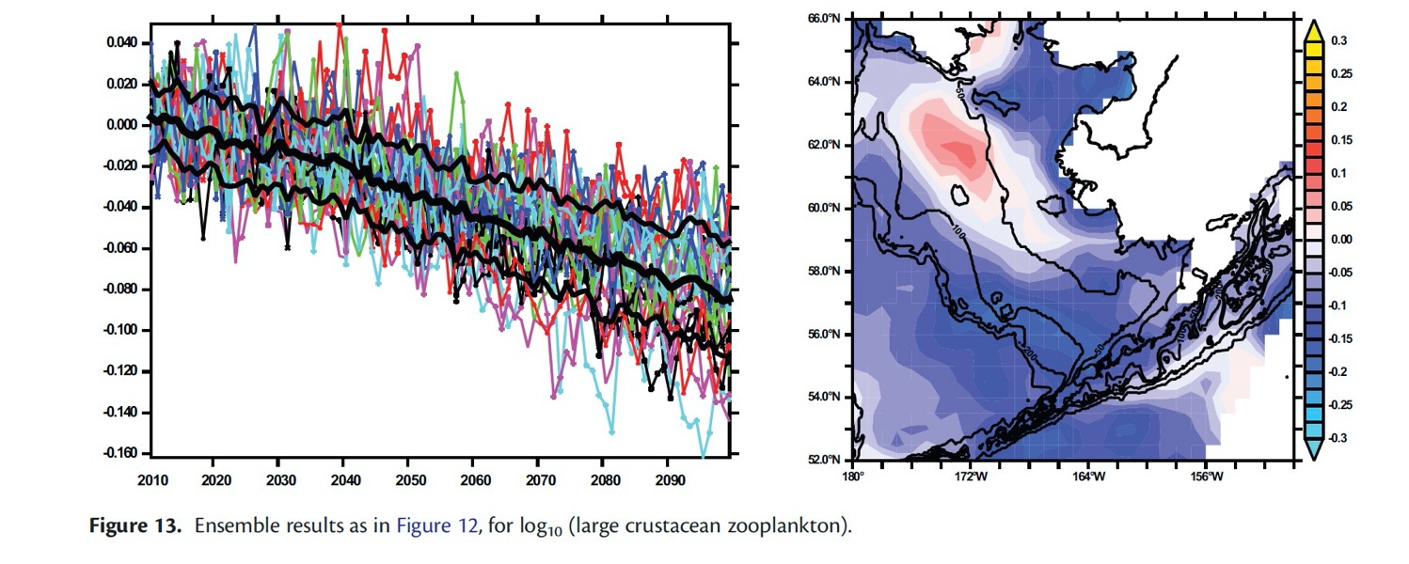
Results: Downscaled Bering10K ROMSNPZ high-resolution model (H16)
DECLINES IN LARGE ZOOPLANKTON (2090-2099)-(2010-2019)
Hermann, A. J., G.A. Gibson, W. Cheng, I. Ortiz1,K. Aydin, M. Wang, A. B. Hollowed, and K. K. Holsman. (2019) Projected biophysical conditions of the Bering Sea to 2100 under multiple emission scenarios. ICES. doi: 10.1093/ices/fsz043

Slide 19
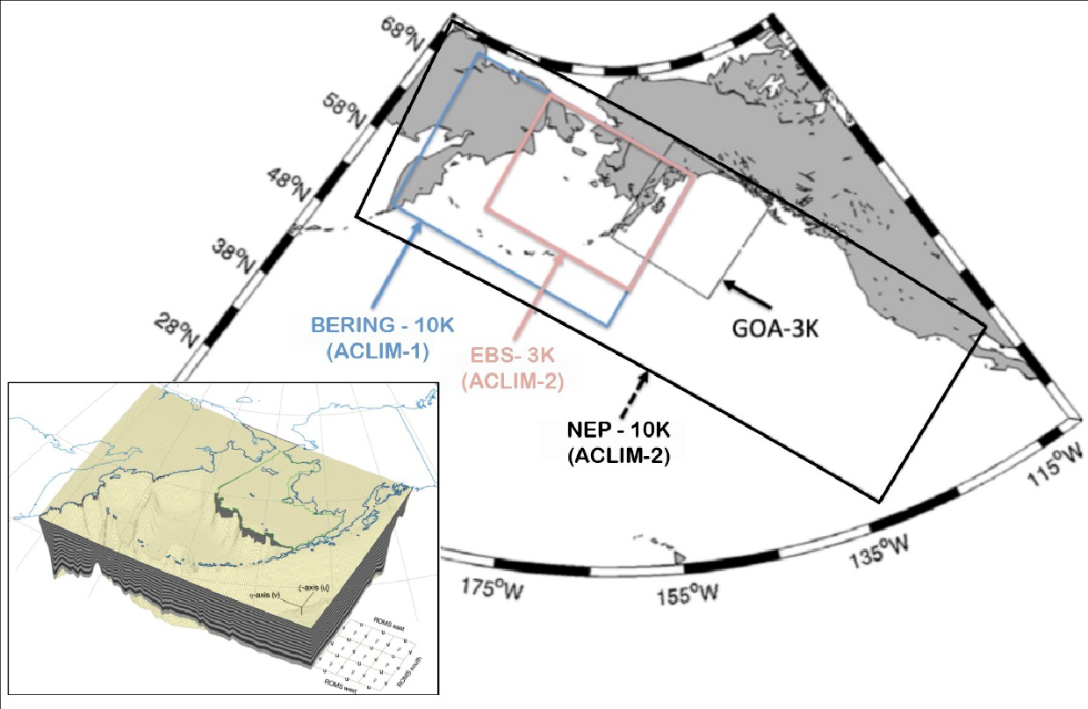
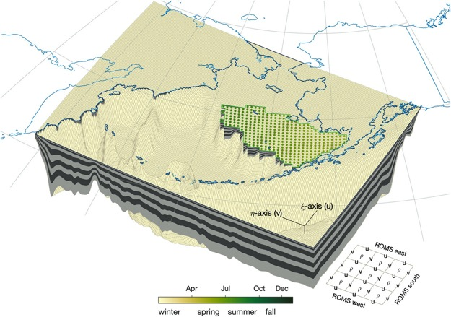
ACLIM Phase 2
ACLIM 1 : 10layer model (H16)
30 layer model (K20D19)
Hermann et al. 2013,2016, 2019; Kearney et al. 2020; Hollowed et al. 2020. Frontiers in Mar. Sci. doi: 10.3389/fmars.2019.00775

Slide 20
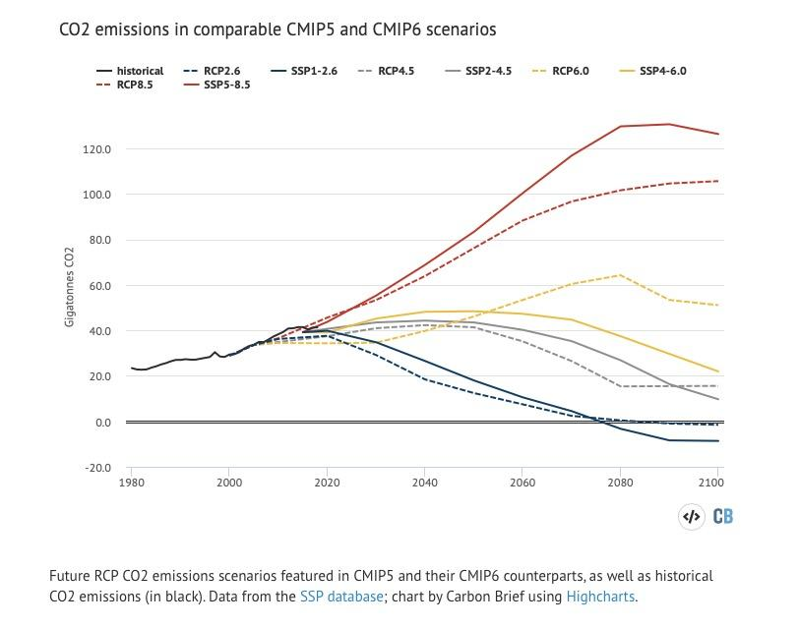
GFDL
CESM
MIROC
Low carbon mitigation
Moderate carbon mitigation
High carbon mitigation
ACLIM1.0 (CMIP5)
SSP585
SSP126
ACLIM2.0 (CMIP6)
GFDL
CESM
MIROC
RCP8.5
RCP4.5
GFDL
CESM
MIROC
GFDL
CESM
MIROC
Notes:
“Socio-economic and emission scenarios are used in climate research to provide plausible descriptions of how the future may evolve with respect to a range of variables including socio-economic change, technological change, energy and land use, and emissions of greenhouse gases and air pollutants. They are used as input for climate model runs and as a basis for assessment of possible climate impacts and mitigation options and associated costs. “ Van vuuren et al. 2011
The RCPs should not be interpreted as forecasts or absolute bounds, or be seen as policy prescriptive. The RCPs describe a set of possible developments in emissions and land use, based on consistent scenarios representative of current literature (see Section 2). The RCPs should clearly not be interpreted as boundaries for possible developments with respect to emissions and land use. Similarly, while the RCPs may be used to identify the range of climate impacts associated with different anthropogenic forcing levels, they are not meant to be policy prescriptive, (i.e. no likelihood or preference is attached to any of the individual scenarios of the set). At the same time, the use of the RCPs in climate research may provide important information for decision-making

Slide 21
GLOSSARY OF TERMS
IPCC : UN Intergovernmental Panel on Climate Change
NOAA : National Oceanic and Atmospheric Administration
NMFS : National Marine Fisheries Service
Council : North Pacific Fisheries Management Council
CE - : “Climate Enhanced” -
GCM : General Circulation Model ( Global in scale)
RCP : Representative (carbon) Concentration Pathway
FEP : Fisheries Ecosystem Plan
ROMS : Regional Ocean Modeling System
NPZ : Nutrient Phytoplankton Zooplankton Model
CEATTLE : Climate Enhanced Assessment with Temperature and Trophic Linkages & Energetics Model
FEAST : Forage and Euphausiid Assessment in Space and Time model
SES : coupled Social-Ecological System

Slide 22
ACLIM support
ACLIM 1.0 funding:
Fisheries & the Environment (FATE)
Stock Assessment Analytical Methods (SAAM)
Climate Regimes & Ecosystem Productivity (CREP)
Economic and Human Dimensions Program, AFSC, OAR
NMFS Economics and Human Dimensions Program
NOAA Integrated Ecosystem Assessment Program (IEA)
NOAA Research Transition Acceleration Program (RTAP)
Alaska Fisheries Science Center
ACLIM 2.0 funding:
NOAA’s Coastal and Ocean Climate Applications (COCA) Climate and Fisheries Program
NOAA Integrated Ecosystem Assessment Program (IEA)
Alaska Fisheries Science Center
Collaboration support:
MAPP Bering Seasons & FATE EFH
NPRB & BSIERP Team
GOA-CLIM Team
AFSC REEM, REFM, RACE
ICES PICES Strategic Initiative on climate change and marine ecosystems (SICCME/S-CCME)
NPFMC Climate change task force, the Ecosystem Committee of the NPFMC

Slide 23
ACLIM1 Publications:
(in review) Torre, M. , W. T. Stockhausen, A. J. Hermann, W. Cheng, R. Foy, C. Stawitz, K. Holsman, C. Szuwalski, A. B. Hollowed. (In Review). Early life stage connectivity for snow crab, Chionoecetes opilio, in the eastern Bering Sea: evaluating the effects of temperature-dependent intermolt duration and vertical migration. Deep Sea Research II,
(in review) Whitehouse, G. A., K. Y. Aydin, A. B. Hollowed, K. K. Holsman, W Cheng, A. Faig, A. C. Haynie, A. J. Hermann, K. A. Kearney, A. E. Punt, and T. E. Essington. Bottom-up impacts of forecasted climate change on the eastern Bering Sea food web. Frontiers in Mar. Sci.
(2020) Holsman, K.K., A. Haynie, A. Hollowed, J. Reum, K. Aydin, A. Hermann, W. Cheng, A. Faig, J. Ianelli, K. Kearney, A. Punt. (2020) Ecosystem-based fisheries management forestalls climate-driven collapse. Nature Communications. DOI:10.1038/s41467-020-18300-3
(in review) Thorson, J., M. Arimitsu, L. Barnett, W. Cheng, L. Eisner, A. Haynie, A. Hermann, K. Holsman, D. Kimmel, M. Lomas, J. Richar, E. Siddon. Forecasting community reassembly using climate-linked spatio-temporal ecosystem models. Ecosphere
(Accepted) Szuwalski, W. Cheng, R. Foy, A. Hermann, A. Hollowed, K. Holsman, J. Lee, W. Stockhausen, J. Zheng. Climate change and the future productivity and distribution of crab in the Bering Sea. ICES JMS
(2020) Reum, J. C. P., J. L. Blanchard, K. K. Holsman, K. Aydin, A. B. Hollowed, A. J. Hermann, W. Cheng, A. Faig, A. C. Haynie, and A. E. Punt. 2020. Ensemble Projections of Future Climate Change Impacts on the Eastern Bering Sea Food Web Using a Multispecies Size Spectrum Model. Frontiers in Marine Science 7:1–17.
(2020) Hollowed, A. B., K. K. Holsman, A. C. Haynie, A. J. Hermann, A. E. Punt, K. Aydin, J. N. Ianelli, S. Kasperski, W. Cheng, A. Faig, K. A. Kearney, J. C. P. Reum, P. Spencer, I. Spies, W. Stockhausen, C. S. Szuwalski, G. A. Whitehouse, and T. K. Wilderbuer. 2020. Integrated Modeling to Evaluate Climate Change Impacts on Coupled Social-Ecological Systems in Alaska. Frontiers in Marine Science 6. https://doi.org/10.3389/fmars.2019.00775
(2019) Holsman, KK, EL Hazen, A Haynie, S Gourguet, A Hollowed, S Bograd, JF Samhouri, K Aydin, Toward climate-resiliency in fisheries management. ICES Journal of Marine Science. 10.1093/icesjms/fsz031
(2019) Hermann, A. J., G.A. Gibson, W. Cheng, I. Ortiz1, K. Aydin, M. Wang, A. B. Hollowed, and K. K. Holsman. Projected biophysical conditions of the Bering Sea to 2100 under multiple emission scenarios. ICES Journal of Marine Science, fsz043, https://doi.org/10.1093/icesjms/fsz043
(2019) Reum, J., JL Blanchard, KK Holsman, K Aydin, AE Punt. Species-specific ontogenetic diet shifts attenuate trophic cascades and lengthen food chains in exploited ecosystems. Okios DOI: 10.1111/oik.05630
(2019) Reum, J., K. Holsman, KK, Aydin, J. Blanchard, S. Jennings. Energetically relevant predator to prey body mass ratios and their relationship with predator body size. Ecology and Evolution (9):201–211 DOI: 10.1002/ece3.4715

Slide 24
ACLIM1 findings
Downscaling is needed
Projections based on global climate models may underestimate future variance
Accounting for predation changed the direction of projections from increases (single-sp model) to declines (multi-sp)
Most pollock and cod scenarios crashed under business as usual (RCP8.5) by 2100; carbon mitigation (RCP 4.5) may lessen or prevent declines
Changing harvest rates through management can help lessen climate impacts, to a point. EBFM can forestall climate declines and provide critical time to adapt.
Ecological projections need to account for trophic interactions
Mitigation is lower risk
Adaptation through fisheries management
Notes:
GCMs may underestimate variance in projections

Slide 25
ACLIM 2.0 Next Directions
EBS Social- ecological system climate risk analysis
Expanded management scenarios
Social network modeling & Co-production of knowledge
Spatial distribution models & NEBS
Expanded protected species analyses (marine mammals!)
Expanded OA and O2 modeling
Expanded lower trophic and YOY modeling
GOA through Northern Bering ACLIM via GOA-CLIM
Notes:
Adaptation goals, limits, and thresholds evolve over time (Adger et al. 2009)
Craft, B., & Fisher, S. (2018). Measuring the adaptation goal in the global stocktake of the Paris Agreement. Climate Policy. https://doi.org/10.1080/14693062.2018.1485546
Adaptation goals differ across people and communities
- are specific to the values
- Change over time Adger 2010
any limits to adaptation depend on the goals of adaptation, which are themselves dependent on diverse values.
adaptation need not be limited by uncertain knowledge of future climate change.
social and individual characteristics act as limits to adaptation
the systematic undervaluation of involuntary loss of places and cultures disguises real, experienced but subjective limits to adaptation
“issues of values and ethics, risk, knowledge and culture construct societal limits to adaptation, but that these limits are mutable”
Adger et al. (2009). Are there social limits to adaptation to climate change? Climatic Change, 93(3–4), 335–354. https://doi.org/10.1007/s10584-008-9520-z

Slide 26
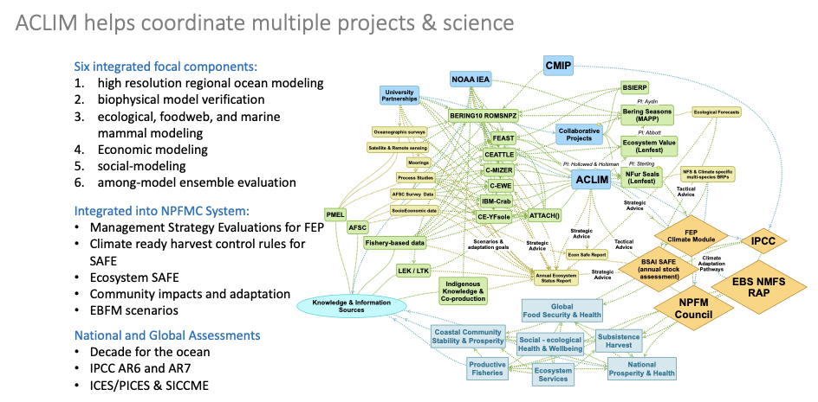
Notes:
Adaptation goals, limits, and thresholds evolve over time (Adger et al. 2009)
Craft, B., & Fisher, S. (2018). Measuring the adaptation goal in the global stocktake of the Paris Agreement. Climate Policy. https://doi.org/10.1080/14693062.2018.1485546
Adaptation goals differ across people and communities
- are specific to the values
- Change over time Adger 2010
any limits to adaptation depend on the goals of adaptation, which are themselves dependent on diverse values.
adaptation need not be limited by uncertain knowledge of future climate change.
social and individual characteristics act as limits to adaptation
the systematic undervaluation of involuntary loss of places and cultures disguises real, experienced but subjective limits to adaptation
“issues of values and ethics, risk, knowledge and culture construct societal limits to adaptation, but that these limits are mutable”
Adger et al. (2009). Are there social limits to adaptation to climate change? Climatic Change, 93(3–4), 335–354. https://doi.org/10.1007/s10584-008-9520-z

Slide 27
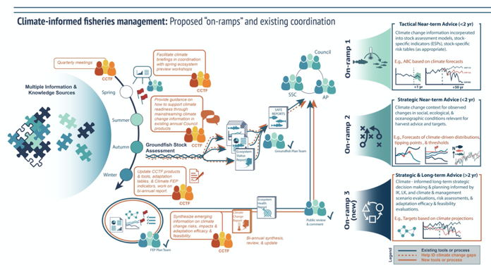
ACLIM informs management
Council’s FEP Climate Change Task Force process
Notes:
Adaptation goals, limits, and thresholds evolve over time (Adger et al. 2009)
Craft, B., & Fisher, S. (2018). Measuring the adaptation goal in the global stocktake of the Paris Agreement. Climate Policy. https://doi.org/10.1080/14693062.2018.1485546
Adaptation goals differ across people and communities
- are specific to the values
- Change over time Adger 2010
any limits to adaptation depend on the goals of adaptation, which are themselves dependent on diverse values.
adaptation need not be limited by uncertain knowledge of future climate change.
social and individual characteristics act as limits to adaptation
the systematic undervaluation of involuntary loss of places and cultures disguises real, experienced but subjective limits to adaptation
“issues of values and ethics, risk, knowledge and culture construct societal limits to adaptation, but that these limits are mutable”
Adger et al. (2009). Are there social limits to adaptation to climate change? Climatic Change, 93(3–4), 335–354. https://doi.org/10.1007/s10584-008-9520-z

